Slide 1
Chapter 15
Project Management
Athena Alimirzaei
Operations Management Area
Jindal School of Management
University of Texas at Dallas
Richardson, TX 75080
U. S. A.

Slide 2
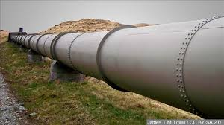


1. Introduction
Project: A unique, one-time operations designed to accomplish a specific set of objectives in a limited time frame.
Examples of project:
  Constructing Dakota Access Pipeline
  Organizing 2020 Summer Olympics in Tokyo
  Building Liaoning air carrier
When a project is undertaken, people with diverse
knowledge and skills are brought together to form
a temporary organization, which is normally disbanded
following the completion of the project.

Slide 3


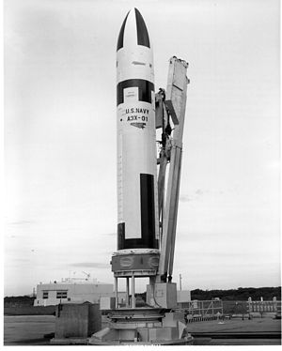
1. Introduction
History of project management:
  CPM (Critical Path Method) -
  (1) Developed by Du Pont and Remington Rand
  in 1959.
  (2) One time estimate for each activity in a project.
  PERT (Program Evaluation and Review Technique) -
  (1) Used by U.S. Navy in 1958 when developing the
  Polaris missile.
  (2) Three time estimates for each activity in a project.
  CPM and PERT are very similar but slightly different -
  (1) CPM → Deterministic PERT.
  (2) PERT → Probabilistic PERT.

Slide 4

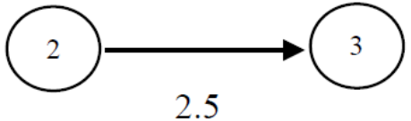
2. PERT Networks
PERT uses a network to depict the major activities of a project and their sequential relationships. The major components of a project network are:
  Arrow ( ): An activity.
  Node ( ): Beginning or ending of an activity.
  Number (7, 36, 4.8, etc.): Estimated time required to complete an activity.
PERT conventions:
(1) A PERT network has a beginning node and an ending node.
(2) Nodes are numbered, each activity is identified by its starting and ending node numbers, and starting node number must be smaller than ending node number.

Slide 5
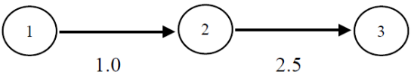
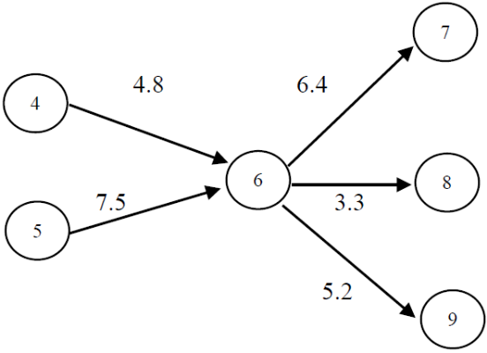
2. PERT Networks
PERT conventions: (cont’d)
(3) Activities must be performed in sequence.
(4) At any node, all entering activities must be completed before any activity that is to begin at the node can start.
Notes:
Today, auctions have been used to conduct a huge volume of transactions, such as the sale of houses, cars, private collection and government project. Auctions have experienced exponential growth in terms of sales volume, revenue, and product categories. In addition, New auctions continue to be designed and implemented.

Slide 6
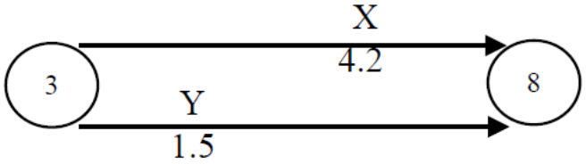
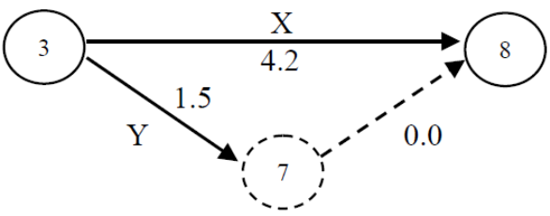
2. PERT Networks
PERT conventions: (cont’d)
(5) When two activities have the same beginning and ending nodes, a dummy node and a dummy arrow are created to form a dummy activity with zero activity time to preserve the separate identity of each activity.

Slide 7
2. PERT Networks
PERT conventions: (cont’d)
(6) The use of dummy activities should be minimized.
(7) No arrows may intersect with one another.
Glossary:
  Path: A sequence of activities from the beginning node to the ending node.
  Path length: The sum of the time estimates of the activities on a path.
  Critical path: The longest path in a PERT network.
  Critical activities: The activities on the critical path.
  Project duration: The length of the critical path\.
  Path slack: The difference between the project duration and the path length.

Slide 8
3. Enumeration Method
When only one time estimate is assigned to each activity, the enumeration method may be used to perform a deterministic PERT analysis to obtain the following information:
(1) A graphical display of all the project activities and their sequential relationships.
(2) An estimate of how long it would take to complete the project.
(3) An indication of which activities are critical to the timely completion of the project.
(4) An indication of how long an activity can be delayed without affecting the project completion time.

Slide 9
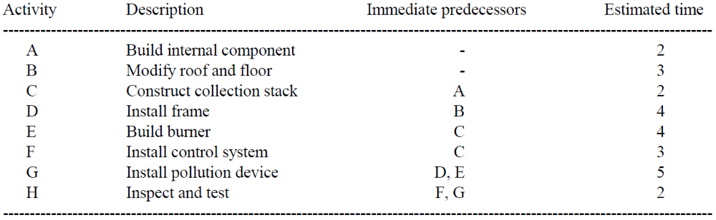
3. Enumeration Method
Example 15.1: Activities involved in a project and their time estimates (in weeks) are shown in the following table:
(1) Construct a PERT network for the project.
(2) Use the enumeration method to analyze the project network and answer the following questions:

Slide 10
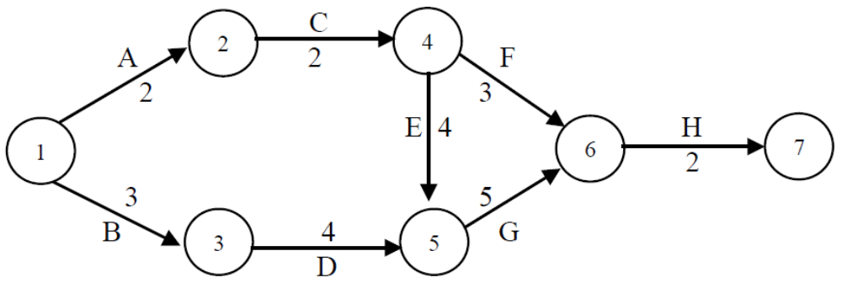
3. Enumeration Method
Example 15.1: (cont’d)
(a) What is the critical path? What are the critical activities?
(b) What is the duration of the project?
(c) What is the duration of the project?
[Solutions] (1) The PERT network is shown below:
Notes:
In the existing auction literature, there are four types of auctions.
The first type is ascending-bid auction. In ascending-bid auction, the auction starts at a relatively low price and continues to increase it until only one bidder remains. The English auction is the most commonly used ascending-bid auction. It is so named because it is traditionally used by leading English auction houses, such as, Sotheby’s and Christie’s.
The second type is descending-bid auction, which is the opposite of the ascending-bid auction in that the auctioneer starts with a high price and continues to lower it till one bidder shows his willingness to pay. Dutch auction is the most commonly used descending auction.
The third type is sealed-bid first-price auction. Under this auction type, the bidding information is confidential to other bidders, only the auctioneer has access to it. The highest bidder is the winner and pays what he actually bid.
However, in the last auction type, sealed-bid second-price auction, the information about other bids is unavailable. The highest bidder is still the winner, however, he pays the second highest bid.
This is the difference between sealed-bid first price auction and sealed-bid second price auction.

Slide 11
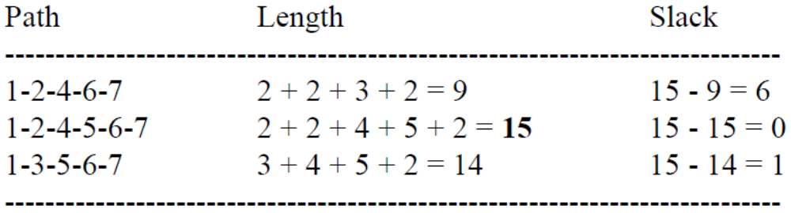
3. Enumeration Method
Example 15.1: (cont’d)
[Solutions] (2) Based on the enumeration method, we have:
(a) The critical path is 1-2-4-5-6-7. The critical activities are 1-2, 2-4, 4-5, 5-6, and 6-7.
(b) The duration of the project is 15 weeks.
(c) Path 1-2-4-6-7 has a slack of 6 weeks, and path 1-3- 5-6-7 has a slack of 1 week.

Slide 12
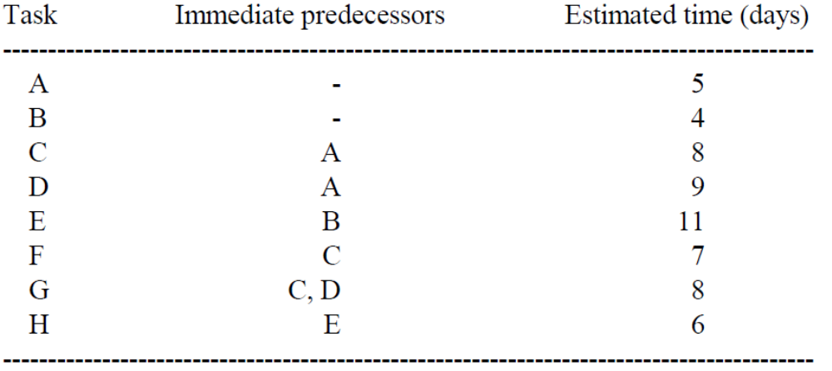
3. Enumeration Method
Example 15.2: The following tasks are required to complete a software development project:
(1) Construct a PERT network for the project.
(2) Use the enumeration method to analyze the project network and answer the following questions:

Slide 13
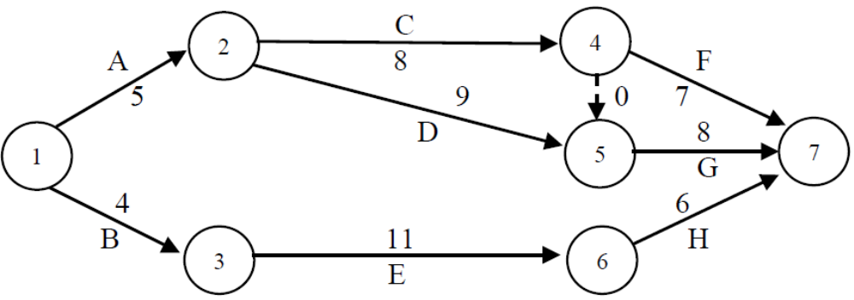
3. Enumeration Method
Example 15.2: (cont’d)
(a) What is the critical path? What are the critical activities?
(b) What is the project duration?
(c) Are there any path slacks? If so, how long is each of the slacks?
[Solutions] (1) The PERT network is shown below:
Notes:
This dissertation focuses on the second type, descending-bid auction, Especially, Dutch auctions.
The Dutch auction is also termed as a clock auction since the auctioneer uses a clock or other electronic devices in the front of the auctioning room to display the properties of the product, available quantity, and so on. The auctioneer sets the hand of a clock at a high price and continues to lower it until a bidder stops the clock by pushing a button to show his willingness to pay.
Since the bidding price changes from high to low, it is a descending-bid auction.
Dutch auction is so named because it has been used for centuries to sell tulips and other flowers in the Netherlands. VBA and BVH are two largest flower auction houses in the world. They trade over 30 million flowers in nearly 60,000 transactions per day, and generate more than $2.4 billion dollars per year.
Dutch auctions especially work well for perishable products, such as flowers, sea food, and products whose values decrease with time, such as. air flight seats and newspapers.

Slide 14
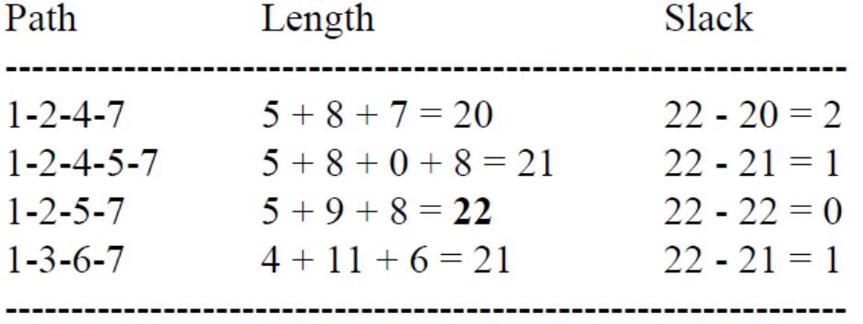
3. Enumeration Method
Example 15.2: (cont’d)
[Solutions] (2)
(a) The critical path is 1-2-5-7, and the critical activities are 1-2, 2-5, and 5-7.
(b) It will take 22 days to complete the project.
(c) The path 1-2-4-7 has a slack of 2 days. Paths 1-2-4- 5-7 and 1-3-6-7 each have a slack of 1 day.
Notes:
There are some other applications of Dutch auction in real world.

Slide 15
4. Computational Algorithm
The enumeration method is appropriate for analyzing small deterministic PERT networks. However, the most appropriate approach for large project networks is the computational algorithm.
Notation:
  ES: The earliest starting time of an activity.
  EF: The earliest finishing time of an activity.
  LS: The latest starting time of an activity.
  LF: The latest finishing time of an activity.
Once ES, EF, LS, and LF are computed for each project activity, the following information may be obtained:

Slide 16
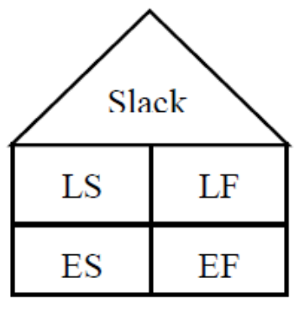
4. Computational Algorithm
(1) Activity slack, which is equal to LS - ES or LF - EF.
(2) Critical activity, which is an activity with zero slack.
(3) Noncritical activity, which is an activity with a positive slack.
(4) Project duration, which is equal to the LF of any ending activity or the largest of the EFs of all ending activities.
To facilitate the implementation of the
computational algorithm, an empty “house”
is built alongside each activity in the PERT
network and each of the five spaces is to be
filled with the appropriate information.
Notes:
This dissertation differs from the work of Yuen (2002) from several perspectives.
Firstly, from research scope perspective, Yuen et al. (2002) only focus on deriving the optimal bid decrements, however, this dissertation goes beyond that to uncover the properties of both the optimal bid levels and the maximum expected revenue. A closed-form expression for computing the optimal bid levels and the maximum expected revue are also developed, which allows us to analyze the impact of each of the number of bidders and the number of bid levels on the auction outcome.
Secondly, the background of the work of Yuen et al. (2002) is the online Dutch auction with the communication cost related to the server resources, signal processing. However, this dissertation is mainly concerned with traditional fast Dutch auctions without communication cost.

Slide 17
4. Computational Algorithm
The implementation of the computational algorithm involves three steps:
(1) Forward pass - It goes from left to right to fill the bottom half of each house.
(2) Backward pass - It goes from right to left to fill the top half of each house.
(3) Fill the roof of each house.
Example 15.3: Refer to the PERT network for Example 15.1. Apply the computational algorithm to determine (1) project completion time, (2) critical path and critical activities, and (3) activity slacks.

Slide 18
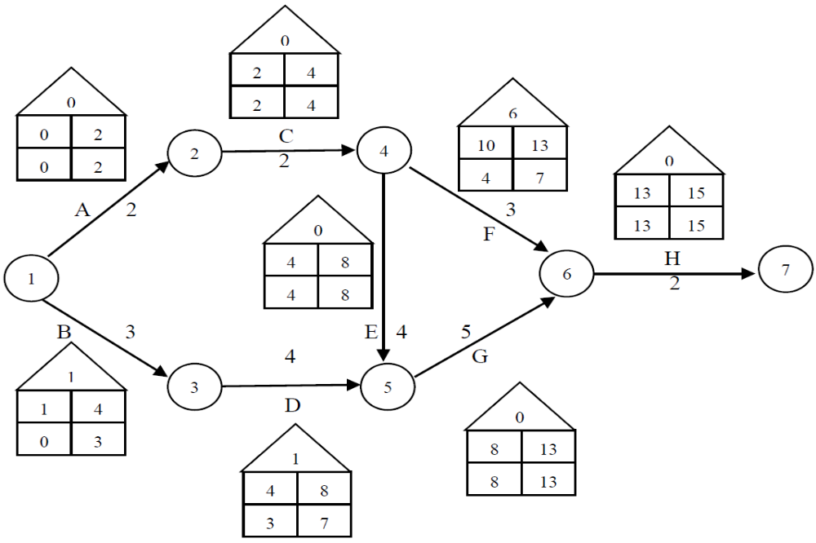
4. Computational Algorithm
Example 15.3: (cont’d)
[Solutions] The results are shown below:

Slide 19
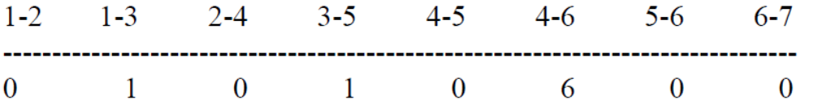
4. Computational Algorithm
Example 15.3: (cont’d)
[Solutions] (1) The project completion time is 15 weeks from the beginning day.
(2) The critical path is 1-2-4-5-6-7. The critical activities are 1-2, 2-4, 4-5, 5-6, and 6-7.
(3) The activity slacks (in weeks) are summarized below:

Slide 20
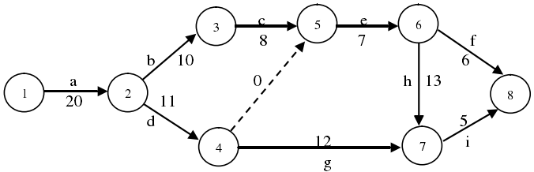
4. Computational Algorithm
Example 15.4: Refer to the PERT network below. Apply the computational algorithm to determine (1) project completion time, (2) critical path and critical activities, and (3) activity slacks.

Slide 21
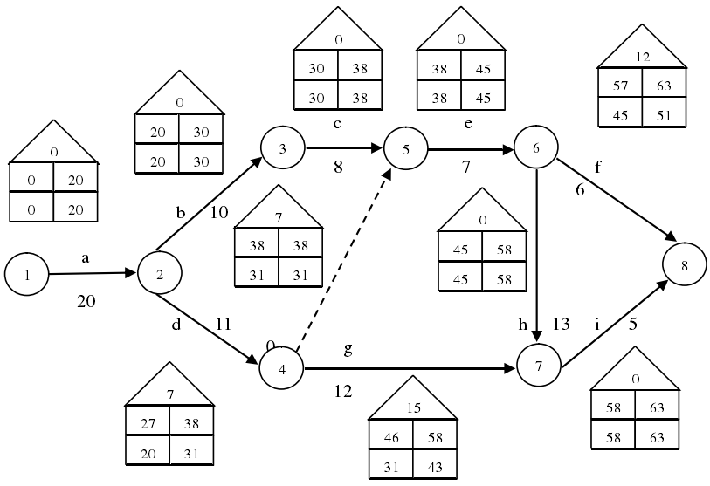
4. Computational Algorithm
Example 15.4: (cont’d)
[Solutions]

Slide 22
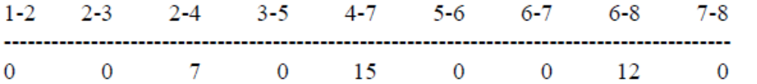
4. Computational Algorithm
Example 15.4: (cont’d)
[Solutions] (1) The project completion time is 63 weeks from the beginning day.
(2) The critical path is 1-2-3-5-6-7-8. The critical activities are 1-2, 2-3, 3-5, 5-6, 6-7, and 7-8.
(3) The activity slacks (in weeks) are summarized below:

Slide 23
5. LP Approach to Project Management
Remark: It is possible to It is possible to formulate the project management problem as a linear program and then solve it to determine the project duration.
Example 15.5: Reconsider the project management problem discussed in Example 15.1.
(1) Develop a linear programming model for determining the project duration.
(2) Run Solver to solve the LP in (1). Be sure to include a copy of the Answer Report and interpret the optimal objective function value.
(3) Is the computer solution in (2) above consistent with the manual solution based on the enumeration method in Example 15.1 and that based on the computational algorithm in Example 15.3?
[Solution] (1) Let I be an imaginary activity starting at node 7 and ending at node 8. We then have:

Slide 24
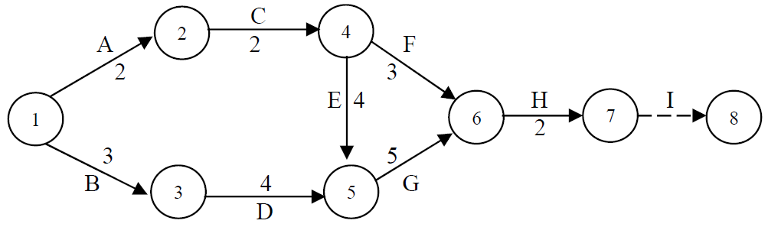
5. LP Approach to Project Management
Example 15.5: (cont’d)
[Solution] (1)
Further let Xi be the earliest starting time of activity i, i = A, B, …, I. It follows that the project duration will be equal to XI. The LP formulation sought is:

Slide 25
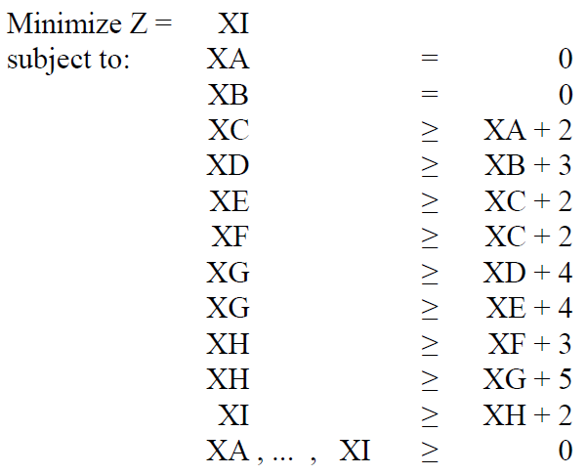
5. LP Approach to Project Management
Example 15.5: (cont’d)
[Solution] (1)
The above LP may be converted into one in standard form below for solution by running Solver:

Slide 26
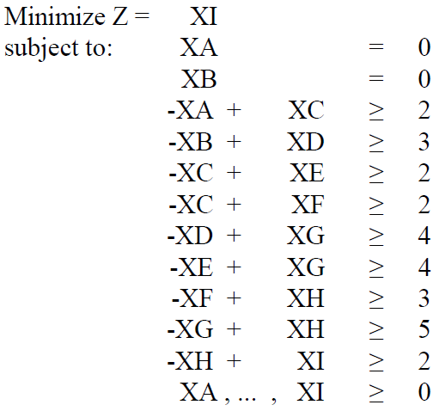
5. LP Approach to Project Management
Example 15.5: (cont’d)
[Solution] (1)
(2) Running Solver to solve the problem, we obtain the following Answer Report. It is seen that the project duration, which is equal to the optimal objective function value, is 15 days.
(3) Yes, they are.

Slide 27
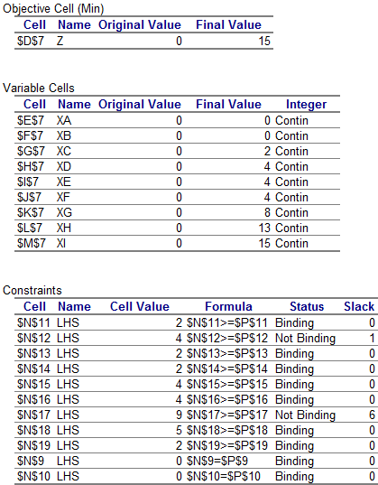
5. LP Approach to Project Management
Example 15.5: (cont’d)
[Solution] (2)

Slide 28
6. Probabilistic PERT Analysis
In a probabilistic PERT, three time estimates are used for each activity:
(1) Optimistic time (a): The amount of time required to finish the activity under the best conditions.
(2) Pessimistic time (b): The amount of time required to finish the activity under the worst conditions.
(3) Most-likely time (m): The amount of time required to finish the activity under the average conditions.
Remark: It should be obvious that a ≤ m ≤ b.

Slide 29
6. Probabilistic PERT Analysis
Notation:
t = Mean (or expected) activity time
s = Standard deviation of activity time
t_{path} = Mean (or expected) path length
s_{path} = Standard deviation of path length
Results:
t = (a + 4m + b)/6
s = (b - a)/6 → s² = (b - a)²/36
t_{path} = Σt
s_{path} = (Σs²)^{1/2} → s_{path}² = Σs²

Slide 30
6. Probabilistic PERT Analysis
By performing a probabilistic PERT analysis of a project network, one can obtain the probability that the project will be completed within a specified period of time. The procedure involves the following steps:
(1) For each activity, compute the expected value (t) and the standard deviation (s) of the activity time.
(2) For each path, compute the expected value (t_{path}) and the standard deviation (s_{path}) of the path length.
(3) For each path, compute the probability that it will be completed before the specified time (t₀), i.e., P(t_{path} ≤ t₀) = P[Z ≤ (t₀ - t_{path})/s_{path}].
(4) Compute the probability that the entire project will be completed before the specified time (t₀) by multiplying the probabilities in (3) together, i.e., P(t_{project} ≤ t₀) = ∏ P[Z ≤ (t₀ - t_{path})/s_{path}].

Slide 31
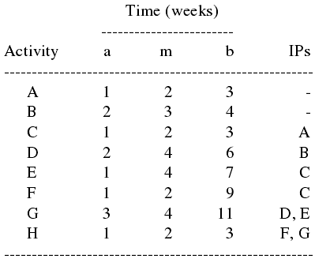
6. Probabilistic PERT Analysis
Example 15.6: What follows is the probabilistic version of the project management problem discussed in Example 15.1:
Perform a probabilistic analysis of the PERT network to determine the probability that the entire project will be completed within 17 weeks.

Slide 32
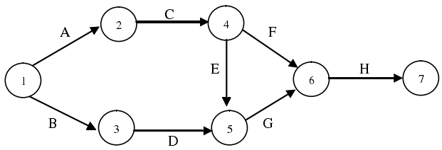
6. Probabilistic PERT Analysis
Example 15.6: (cont’d)
[Solution] The probabilistic PERT network without activity times is shown below:

Slide 33
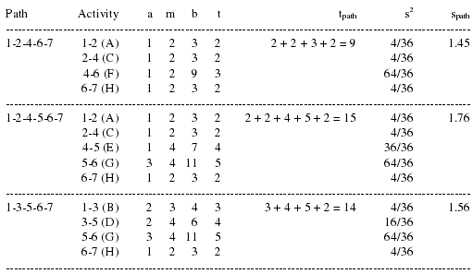
6. Probabilistic PERT Analysis
Example 15.6: (cont’d)
[Solution]

Slide 34
6. Probabilistic PERT Analysis
Example 15.6: (cont’d)
[Solution] Note that t₀ = 17. Referring to standard normal probability tables (see, for example, those on the next two slides), we have
Z₁₋₂₋₄₋₆₋₇ = (17 - 9)/1.45 ≈ 5.52 → P(Z ≤ 5.52) = 1.0000
Z₁₋₂₋₄₋₅₋₆₋₇ = (17 - 15)/1.76 ≈ 1.14 → P(Z ≤ 1.14) ≈ 0.8729
Z₁₋₃₋₅₋₆₋₇ = (17 - 14)/1.56 ≈ 1.92 → P(Z ≤ 1.92) ≈ 0.9726
The probability that the project will be completed within 17 weeks is equal to the joint probability that each of the three paths has a length less than or equal to 17 weeks, i.e., 1.0000(0.8729)(0.9726) ≈ 0.8490.

Slide 35
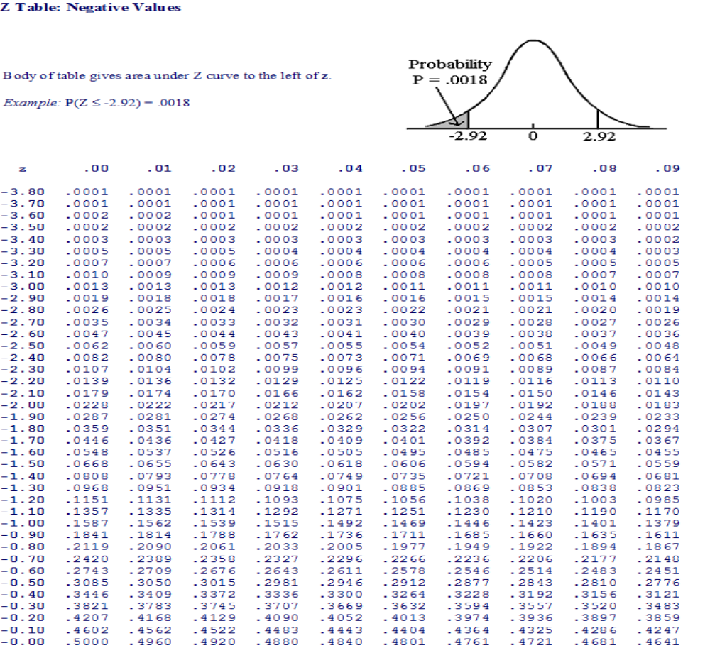
6. Probabilistic PERT Analysis

Slide 36
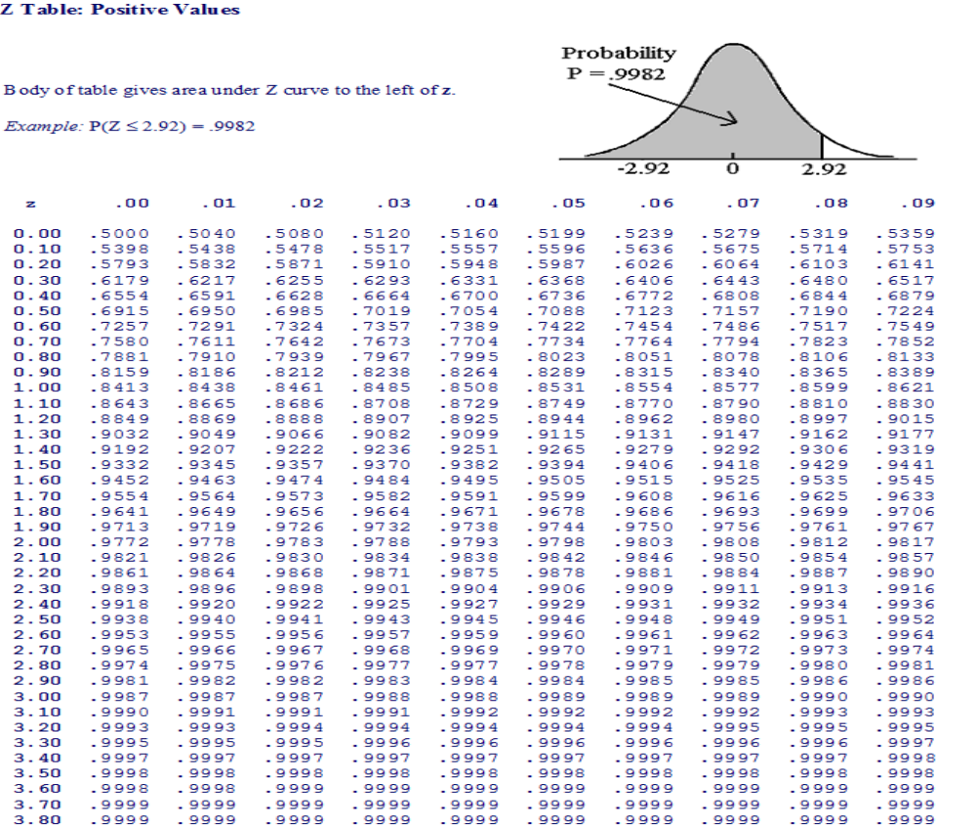
6. Probabilistic PERT Analysis

